Slide 1
Unit V- Introduction to Embedded C
Problem Solving using C- CSE1B

Slide 2
INTRODUCTION TO EMBEDDED C
Structure of embedded C program - Data Types - Operators - Statements - Functions - Keil C Compiler
Practical component:
Simple programs using embedded C

Slide 3
INTRODUCTION TO EMBEDDED C
C for Microcontrollers
From High- level languages, C is the closest to assembly languages
bit manipulation instructions
pointers (indirect addressing)
Most microcontrollers have available C compilers
Writing in C simplifies code development for large projects.
Whenever the conventional “C” language and its extensions are used for programming embedded systems, it is referred to as “Embedded C” programming.

Slide 4
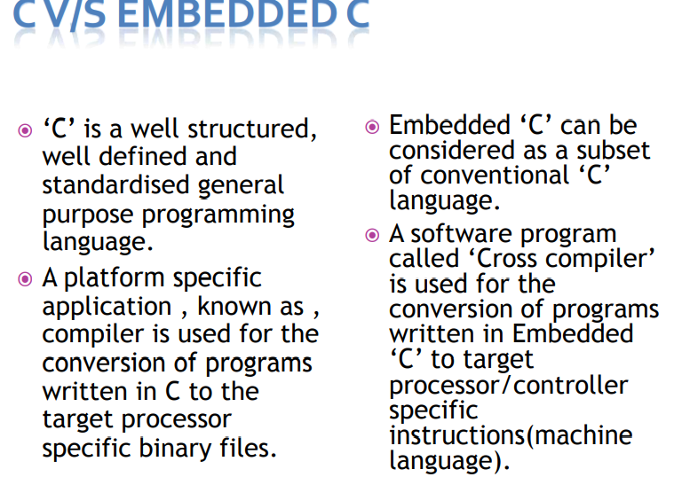
Differences between C and Embedded C

Slide 5
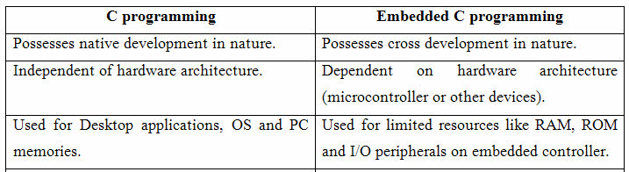
Differences between C and Embedded C

Slide 6
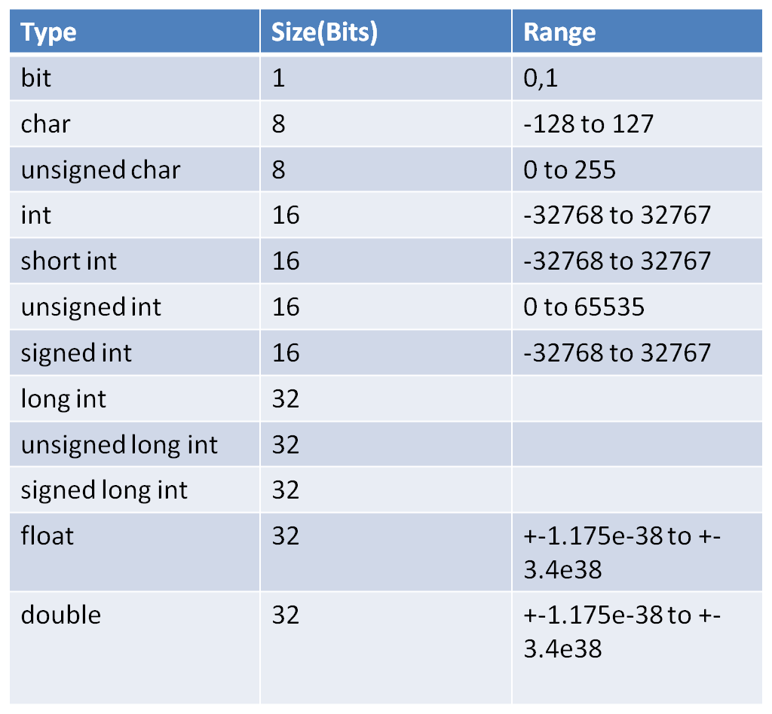
Data types
The data type refers to an extensive system for declaring variables of different types like integer, character, float, etc. The embedded C software uses four data types that are used to store data in the memory.
The ‘char’ is used to store any single character; ‘int’ is used to store integer value, and ‘float’ is used to store any precision floating point value.
The size and range of different data types on a 32-bit machine is given in the following table. The size and range may vary on machines with different word sizes.

Slide 7
OPERATORS - Arithmetic operations
int i, j, k; // 32-bit signed integers
uint8_t m,n,p; // 8-bit unsigned numbers
i = j + k; // add 32-bit integers
m = n - 5; // subtract 8-bit numbers
j = i * k; // multiply 32-bit integers
m = n / p; // quotient of 8-bit divide
m = n % p; // remainder of 8-bit divide
i = (j + k) * (i – 2); //arithmetic expression
*, /, % are higher in precedence than +, - (higher precedence applied 1st)
Example: j * k + m / n = (j * k) + (m / n)
Floating-point formats are not directly supported by Cortex-M3 CPUs.

Slide 8
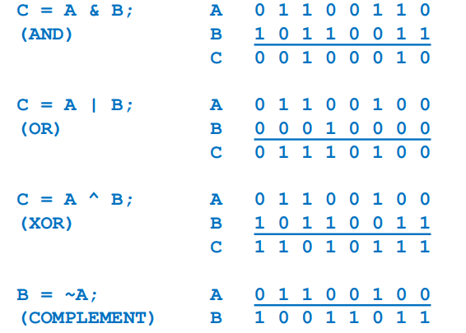
OPERATORS - logical operators
Bit-parallel (bitwise) logical operators produce n-bit results of the corresponding logical operation: & (AND) | (OR) ^ (XOR) ~ (Complement

Slide 9
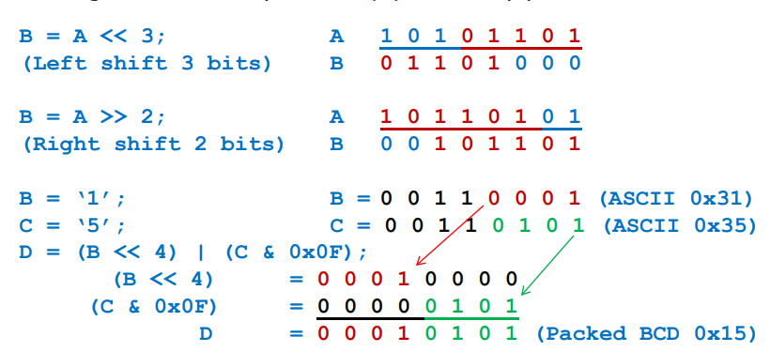
OPERATORS - Shift operators
x >> y (right shift operand x by y bit positions)
x << y (left shift operand x by y bit positions)
Vacated bits are filled with 0’s.
Shift right/left fast way to multiply/divide by power of 2

Slide 10
Keywords in Embedded C
A Keyword is a special word with a special meaning to the compiler (a C Compiler for example, is a software that is used to convert program written in C to Machine Code). For example, if we take the Keil’s Cx51 Compiler (a popular C Compiler for 8051 based Microcontrollers) the following are some of the keywords:
bit
sbit
sfr
small
large

Slide 11
Basic Structure of an Embedded C Program
Multiline Comments . . . . . Denoted using /*……*/
Single Line Comments . . . . . Denoted using //
Preprocessor Directives . . . . . #include<…> or #define
Global Variables . . . . . Accessible anywhere in the program
Function Declarations . . . . . Declaring Function
Main Function
Main Function . . . . . Main Function, execution begins here { Local Variables . . . . . Variables confined to main function Function Calls . . . . . Calling other Functions Infinite Loop . . . . . Like while(1) or for(;;) Statements . . . . . …. …. }
Function Definitions . . . . . Defining the Functions { Local Variables . . . . . Local Variables confined to this Function Statements . . . . . …. …. }

Slide 12
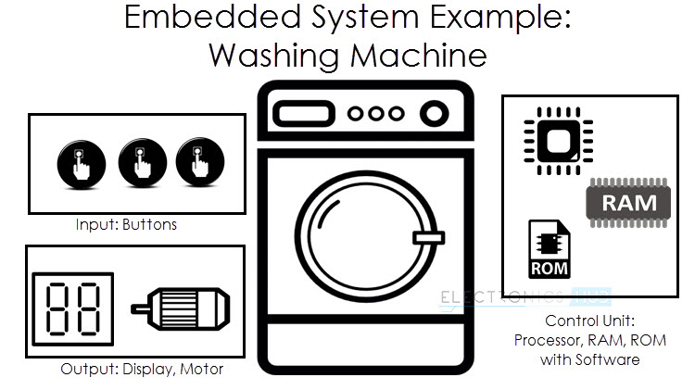
Example

Slide 13
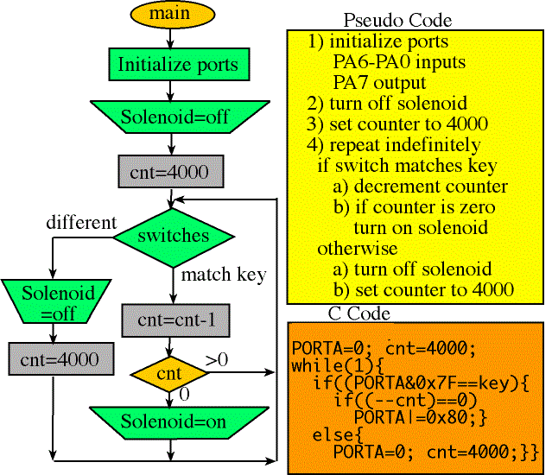
Example

Slide 14
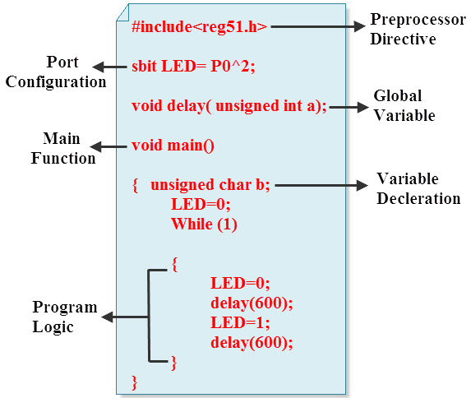
Example

Slide 15
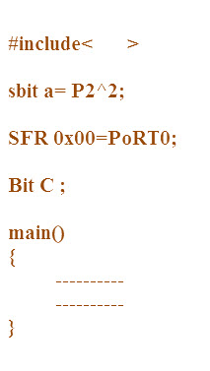
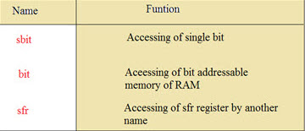
Example

Slide 16
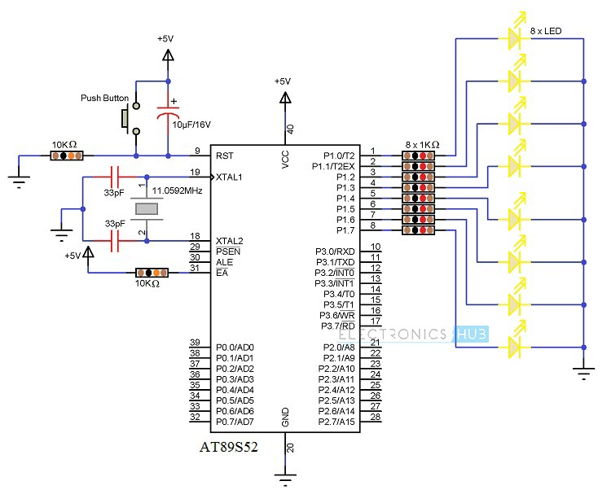
Example

Slide 17
This compiler is a part of the Keil µVision IDE. The program is shown below.
#include<reg51.h> // Preprocessor Directive void delay (int); // Delay Function Declaration
void main(void) // Main Function { P1 = 0x00; /* Making PORT1 pins LOW. All the LEDs are OFF. (P1 is PORT1, as defined in reg51.h) */
while(1) // infinite loop { P1 = 0xFF; // Making PORT1 Pins HIGH i.e. LEDs are ON. delay(1000); /* Calling Delay function with Function parameter as 1000. This will cause a delay of 1000mS i.e. 1 second */
P1 = 0x00; // Making PORT1 Pins LOW i.e. LEDs are OFF. delay(1000); } }
void delay (int d) // Delay Function Definition { unsigned int i=0; // Local Variable. Accessible only in this function. /* This following step is responsible for causing delay of 1000mS (or as per the value entered while calling the delay function) */
for(;d>0;d–) { for(i=250;i>0;i – -); for(i=248;i>0;i – -); } }

Slide 18
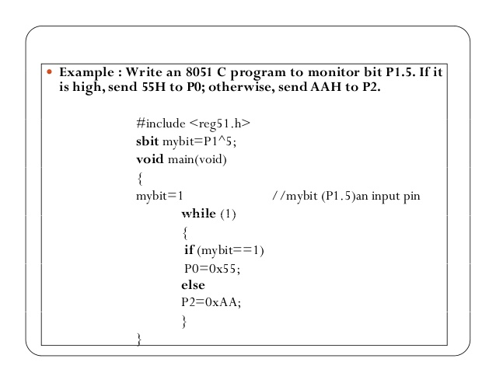
Example

Slide 19
Example

Slide 20
#include<reg51.h>
sbit R1=P1^0;
sbit Y1=P1^1;
sbit G1=P1^2;
sbit R2=P1^3;
sbit Y2=P1^4;
sbit G2=P1^5;
sbit R3=P2^0;
sbit Y3=P2^1;
sbit G3=P2^2;
sbit R4=P2^3;
sbit Y4=P2^4;
sbit G4=P2^5;
void msdelay(unsigned int t)
{
int i,j;
int k=100*t;
for(i=0;i<k;i++)
for(j=0;j<1275;j++);
}
void clear()
{
P1=0x00;
P2=0x00;
}
void main()
{
while(1)
{
clear();
phase1();
clear();
phase2();
clear();
phase3();
clear();
phase4();
}
}
void phase1()
{
R1=1;
R2=1;
G3=1;
R4=1;
msdelay(25);
G3=0;
Y3=1;
Y1=1;
msdelay(5);
}
void phase2()
{
G1=1;
R2=1;
R3=1;
R4=1;
msdelay(25);
G1=0;
Y1=1;
Y2=1;
msdelay(5);
}
void phase3()
{
R1=1;
G2=1;
R3=1;
R4=1;
msdelay(25);
G2=0;
Y2=1;
Y4=1;
msdelay(5);
}
void phase4()
{
R1=1;
R2=1;
R3=1;
G4=1;
msdelay(25);
G4=0;
G2=1;
Y3=1;
msdelay(5);
}

